Slide 1

TRANSMISSION LINES L4

Slide 2
Transmission lines are used to transmit electric energy and signals from one point to another, specifically from a source to a load
This may include the connection between a transmitter and an antenna, connections between computers in a network, or between a hydroelectric generating plant and a substation several hundred miles away
The source may be a hydroelectric generator, a transmitter, or an oscillator
The load may be a factory, an antenna, or an oscilloscope
Transmission lines include coaxial cable, a two-wire line, a parallel-plate or planar line, a wire above the conducting plane, and a microstrip line

Slide 3
TRANSMISSION LINE PARAMETERS
It is customary and convenient to describe a transmission line in terms of its line parameters, which are its resistance per unit length R, inductance per unit length L, conductance per unit length G, and capacitance per unit length C
Each of the lines has specific formulas for finding R, L, G, and C
For coaxial, two-wire, and planar lines, the formulas for calculating the values of R, L, G, and C are provided in Table 1

Slide 4
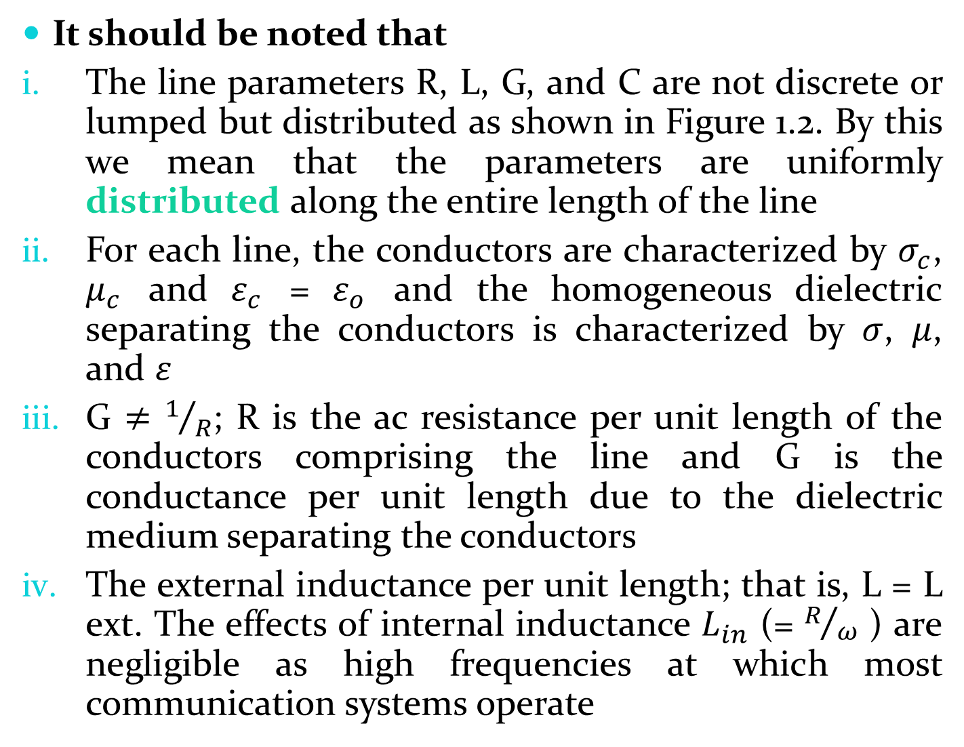
It should be noted that
The line parameters R, L, G, and C are not discrete or lumped but distributed as shown in Figure 1.2. By this we mean that the parameters are uniformly distributed along the entire length of the line
For each line, the conductors are characterized by $σ_{c}$, $μ_{c}$ and $ε_{c}$ = $ε_{o}$ and the homogeneous dielectric separating the conductors is characterized by $σ$, $μ$, and $ε$
G $≠$ $1/R$; R is the ac resistance per unit length of the conductors comprising the line and G is the conductance per unit length due to the dielectric medium separating the conductors
The external inductance per unit length; that is, L = L ext. The effects of internal inductance $L_{in}$ (= $R/ω$ ) are negligible as high frequencies at which most communication systems operate

Slide 5

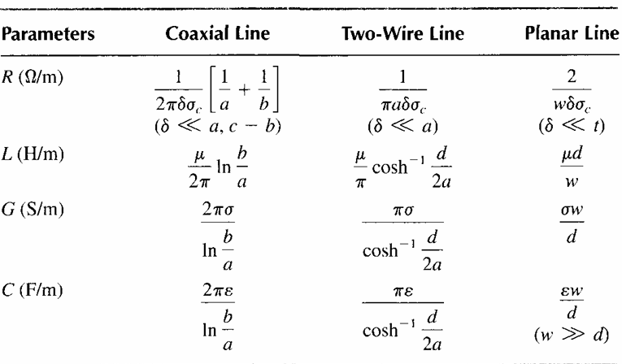
For each line,
Distributed Line Parameters at High Frequencies

Slide 6

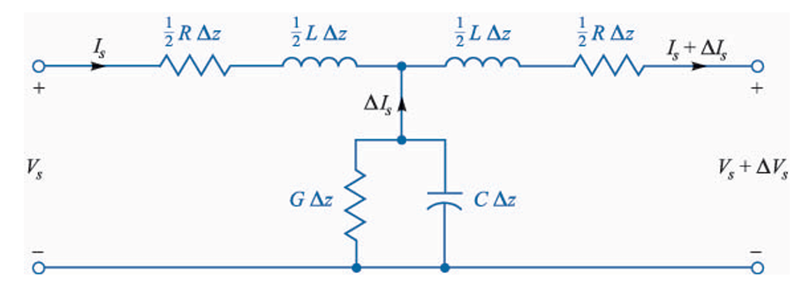
Since we are already familiar with the basic characteristics of wave propagation, let us turn immediately to the case of sinusoidal time variation, and use the notation for complex quantities

Slide 7
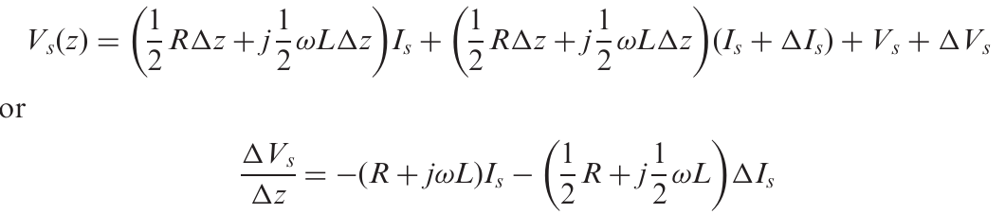
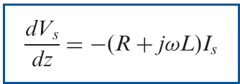

Now write the voltage equation around the perimeter of the circuit above
As we let $∆z$ approach zero, $∆I_{S}$also approaches zero, and the second term on the right vanishes

Slide 8
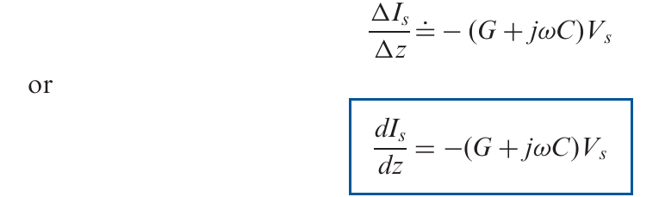


Second equation for current
From

Slide 9


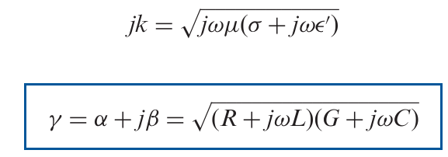

Similarly, from
Carefully comparing the above four equations
Propagation constant ($γ$)

Slide 10




Wavelength ($λ$)
Phase velocity ($v_{p}$)

Slide 11
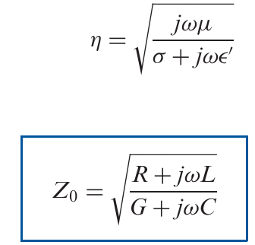
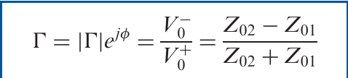

Characteristic impedance ($Z_{O}$)
Reflection coefficient (Г)

Slide 12

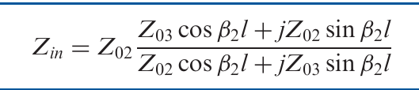

Standing wave ratio (SWR)
Input impedance ($Z_{in}$)

Slide 13


We often terminate a transmission line at z = 0 with a load impedance $Z_{L}$ which may represent an antenna, the input circuit of a television receiver, or an amplifier on a telephone line
The input impedance at z = - $ℓ$ is then written simply as

Slide 14
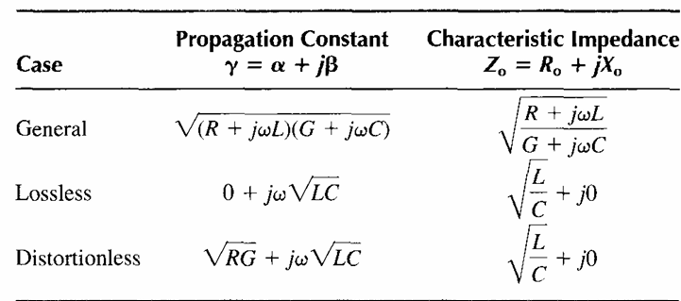
Transmission Line Characteristics

Slide 15

Example
A lossless transmission line is 80 cm long and operates at a frequency of 600 MHz. The line parameters are L = 0.25 $μ$H/m and C = 100 pF/m. Find the
characteristic impedance,
phase constant,
velocity on the line, and
input impedance for $Z_{L}$ = 100 Ω.

